Slide 1

Vel Tech Rangarajan Dr. Sagunthala R&D Institute of Science and Technology
School of Computing
Department of Computer Science and Engineering
10211CS224 / FULL STACK APPLICATION DEVELOPMENT (JAVA)
PROJECT REVIEW : MILESTONE PROJECT – 2
Date: 23-04-2026
Design and develop a React JS based web application for Ticket Booking of an Internal Department Event (such as technical fest, or seminar).
SDG: SDG 9 – Industry, Innovation and Infrastructure
Presented By:
K.BUNNY PREETHAM– VTU26337– 23UECS1273
Courses Handling Faculty:
Dr. S . Hemamalini,M.E,Ph.D.,
Assistant Professor (senior grade)

Slide 2
INTRODUCTION
Background of the Problem
Many departments still rely on manual methods for managing internal event ticket bookings, which leads to inefficiencies such as overbooking, incorrect data entry, delays in processing, and difficulty in maintaining records.
Why This Project is Important
A React JS-based Event Ticket Booking System helps automate the entire process, ensuring accurate bookings, reducing manual effort, and improving the overall experience for both organizers and participants.
Real-World Relevance
This system can be used in colleges and organizations to manage registrations for technical fests, seminars, workshops, and internal events efficiently with real-time updates and better record maintenance.
System Overview
The Event Ticket Booking System is a web-based application designed to streamline internal event registrations and ticket booking.
Key Features:
Event listing with details
Online ticket booking system
User registration and login
Booking history management
1
2
3
4
5
6
7
8
9

Slide 3
PROBLEM STATEMENT
Problem Statement
• Manual booking systems cause overbooking issues • Data entry errors are common • Difficult to track registrations and seat availability • No real-time booking updates for users • Record maintenance is time-consuming • Lack of automation reduces efficiency • Managing multiple events becomes complex • Need for a centralized digital solution
1
2
3
4
5
6
7
8
9

Slide 4
OBJECTIVE(S)
Objectives
• To design and develop an automated Event Ticket Booking System for managing event listings, bookings, and user data. • To improve booking accuracy and track participant registrations through real-time updates and reports. • To implement the system for efficient ticket booking, user management, and event handling. • To evaluate the performance of the system by monitoring booking accuracy, system reliability, and processing speed.
1
2
3
4
5
6
7
8
9

Slide 5
PROPOSED SYSTEM
1
Proposed Solution & Advantages
• Event Ticket Booking System is a digital solution that automates event booking, user management, and ticket generation. • It replaces manual registration with a centralized and secure database system. • The system provides real-time updates on seat availability to prevent overbooking. • Automated booking and ticket generation reduce errors and save time. • User details and booking history are stored for better management and future reference. • Reports help organizers track event participation and performance. • The system improves user experience by providing fast and easy booking. • Compared to manual methods, it ensures accuracy, reliability, and efficient event management.
2
3
4
5
6
7
8
9

Slide 6
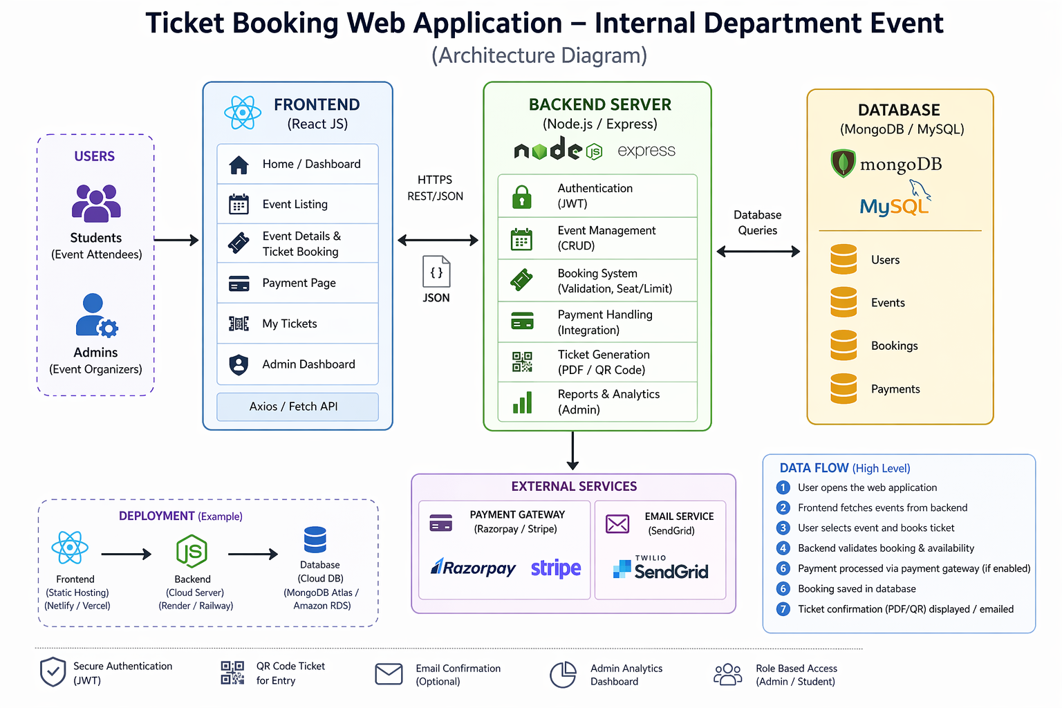


PROPOSED SYSTEM ARCHITECTURE
1
2
3
4
5
6
7
8
9

Slide 7
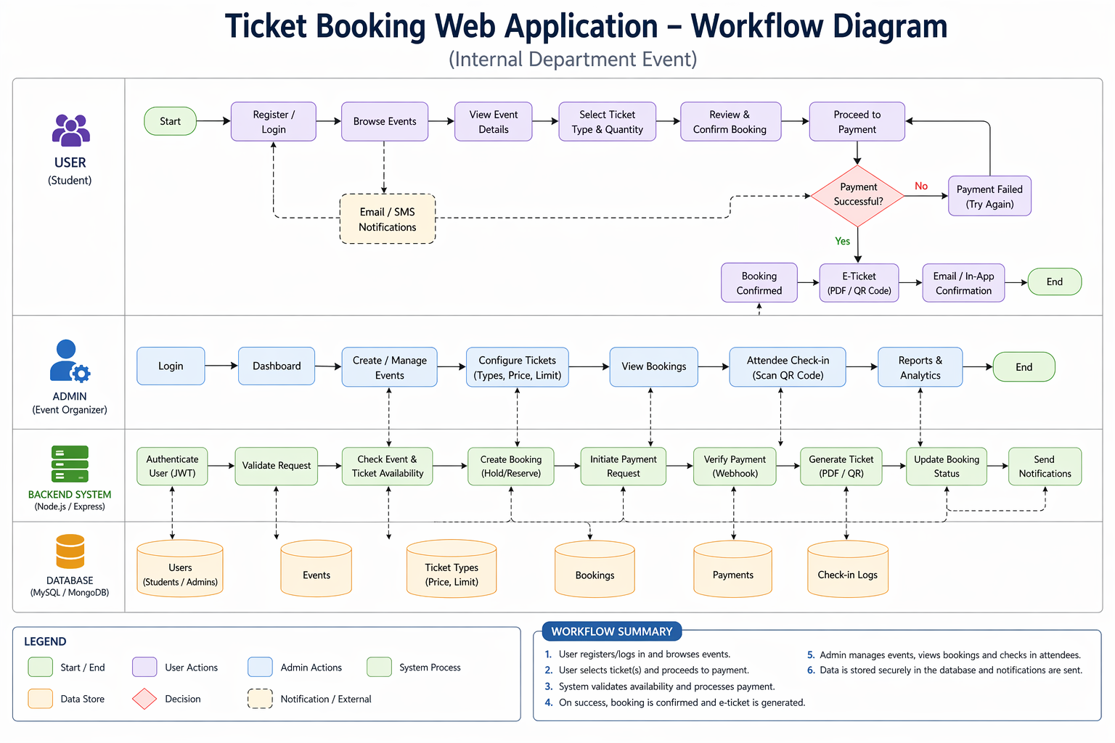
WORKFLOW
1
2
3
4
5
6
7
8
9

Slide 8
TECHNOLOGIES USED
Frontend:
• React JS • HTML, CSS, JavaScript
Backend:
• Node.js with Express.js
Database:
• MySQL
Tools:
• VS Code • MySQL Workbench • Git & GitHub
Hardware/Software Requirements:
• Minimum 4GB RAM • Windows/Linux OS • Node.js & MySQL installed • Web browser • Internet connection
1
2
3
4
5
6
7
8
9

Slide 9
MODULE DESCRIPTION
Module 1:
Handles user registration, login, and authentication..
Module 2:
Displays events and allows users to book tickets.
Module 3:
Stores user data, event details, and bookings securely.
Module 4:
Generates reports on bookings and participant details.

Slide 10
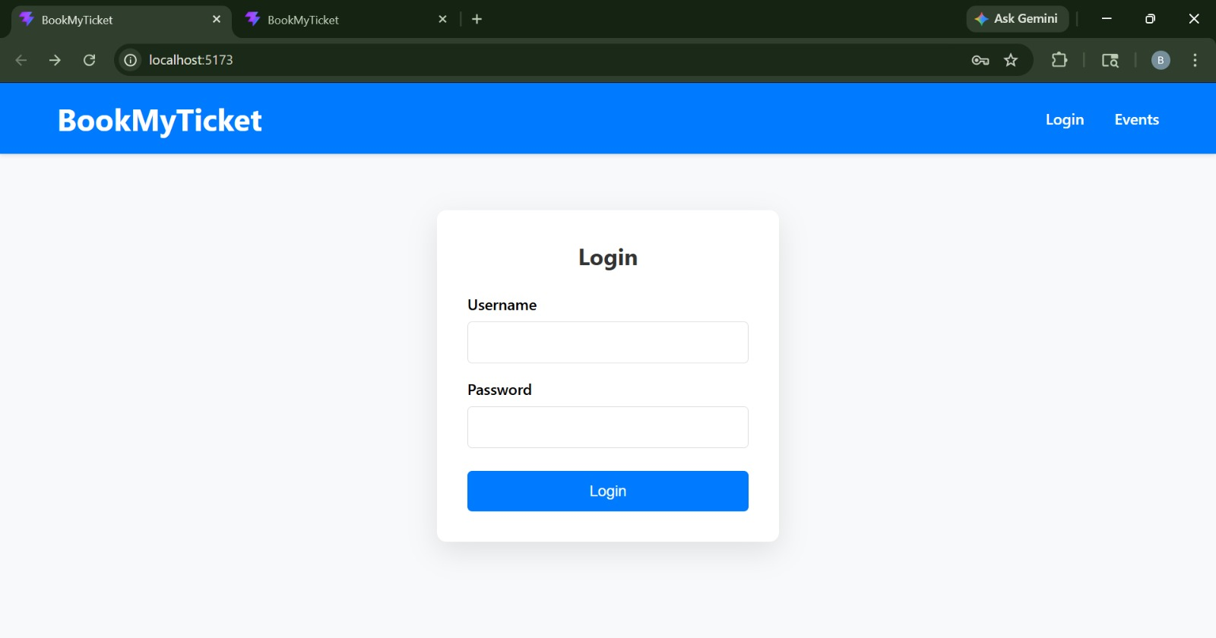
IMPLEMENTATION SCREENSHOTS
1
2
3
4
5
6
7
8
9
The login page allows users to securely enter their credentials (such as email and password) to access the ticket booking system. It validates user input and authenticates the user before granting access to event details and booking features.

Slide 11
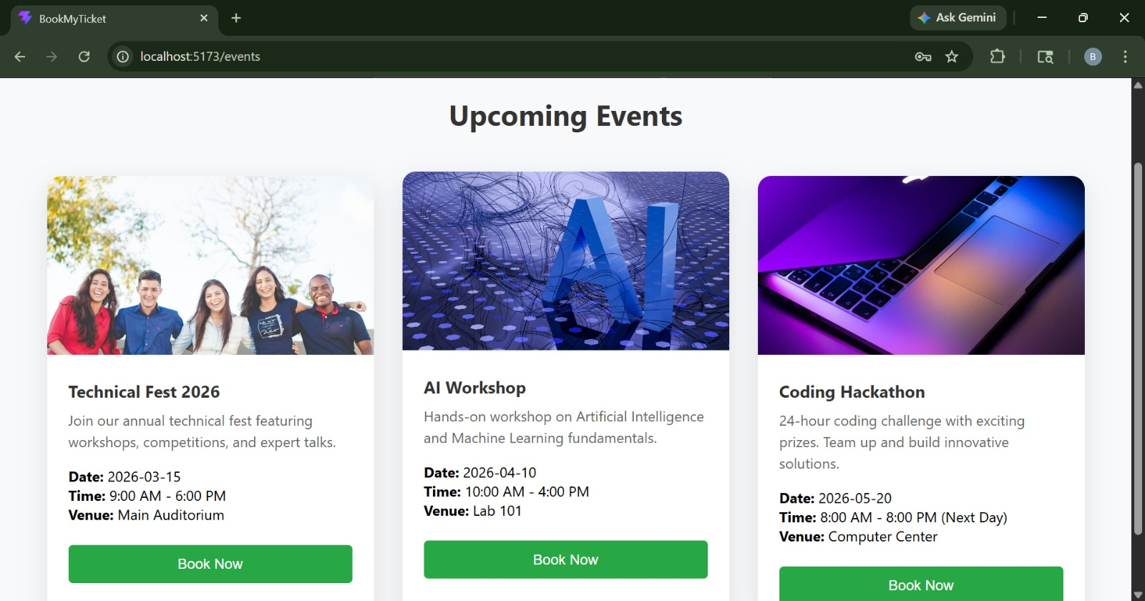
IMPLEMENTATION SCREENSHOTS
1
2
3
4
5
6
7
8(A)
9
The upcoming events page displays a list of all future events with details like date, venue, and ticket availability.It provides a “Book Now” option for each event, allowing users to quickly select and proceed with ticket booking.

Slide 12
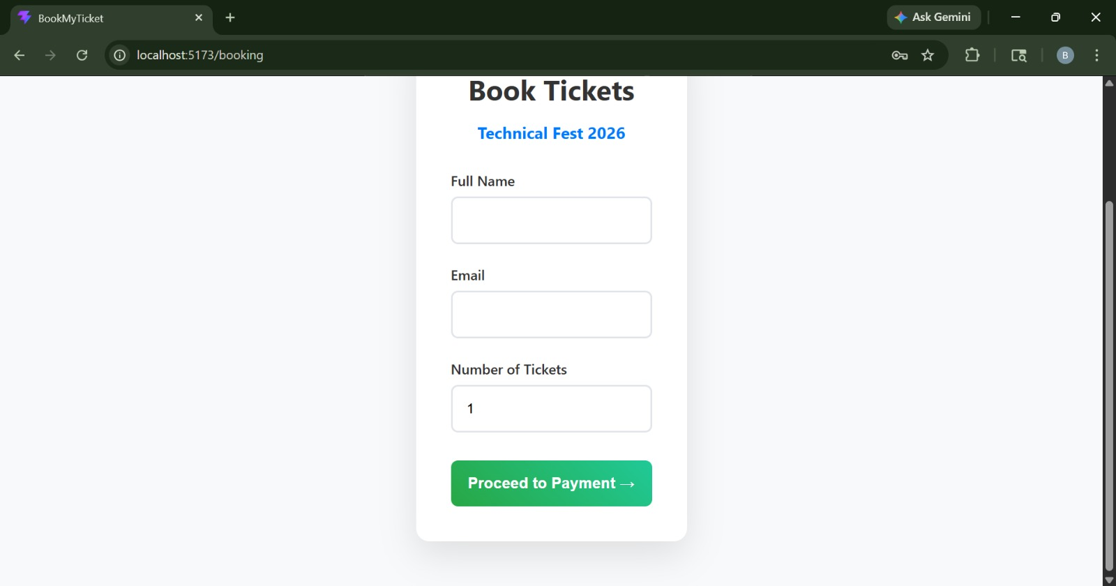
IMPLEMENTATION SCREENSHOTS
1
2
3
4
5
6
7
8(B)
9
This page allows users to enter their personal details such as name, email, department, and number of tickets for booking.It collects and validates the information before confirming the ticket reservation.

Slide 13
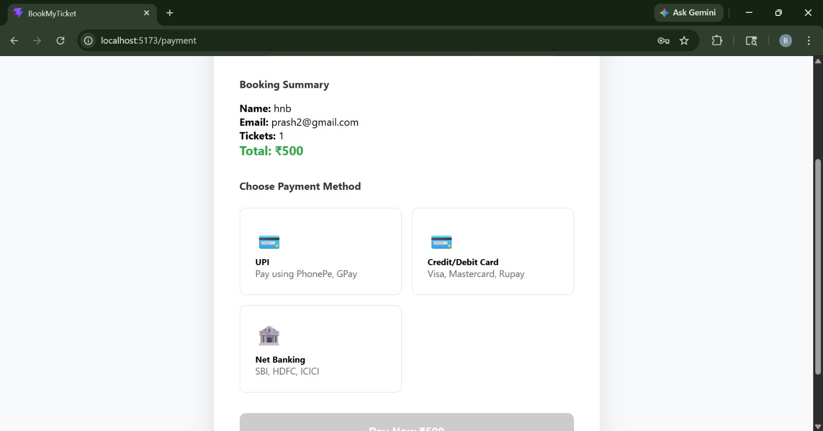
IMPLEMENTATION SCREENSHOTS
1
2
3
4
5
6
7
8(C)
9

Slide 14
ADVANTAGES & LIMITATIONS
1
Advantages of Event Ticket Booking System
Easy to browse available events in one place. Users can quickly book tickets online without hassle. Simple interface makes it easy for users to navigate. Saves time compared to manual booking or standing in queues.
Limitations of Event Ticket Booking System
Requires internet connection to access the system. Limited features compared to large commercial ticketing platforms. Payment integration may be limited or basic. System performance depends on server and database connectivity.
2
3
4
5
6
7
8
9

Slide 15
Thank you

